Slide 1

Machine Learning with Scikit-Learn and TensorFlow (자원탐사 융합해석을 위한 파이썬 라이브러리를 활용한 머신러닝)
KIGAM, Feb 19-23, 2018
Day 5
Daeung Yoon (윤대웅)
Hanyang University

Slide 2

참고 자료
Hands-On Machine Learning with Scikit-Learn and TensorFlow by Aurelien Geron
cs231n (Convolutional Neural Networks for Visual Recognition)
Colah’s blog (http://colah.github.io/posts/2015-08-Understanding-LSTMs/)
강의 자료 및 예제코드 다운로드 주소
https://github.com/duyoon/kigam_ml_seminar_2018

Slide 3
교육 시간표
 | 2.19 (월) | 2.20 (화) | 2.21 (수) | 2.22 (목) | 2.23 (금)
오전 | Python for machine learning | Linear/Logistic Regression | Decision Trees | TensorFlow Basics | Convolutional Neural Networks
오후 | Intro to machine learning | Support Vector Machines | Random Forests | Artificial Neural Networks | Convolutional Neural Networks
 | Data Preprocessing | Model Evaluation | Gradient Boosting | Deep Neural Networks | Recurrent Neural Networks

Slide 4
11. Convolutional Neural Networks

Slide 5
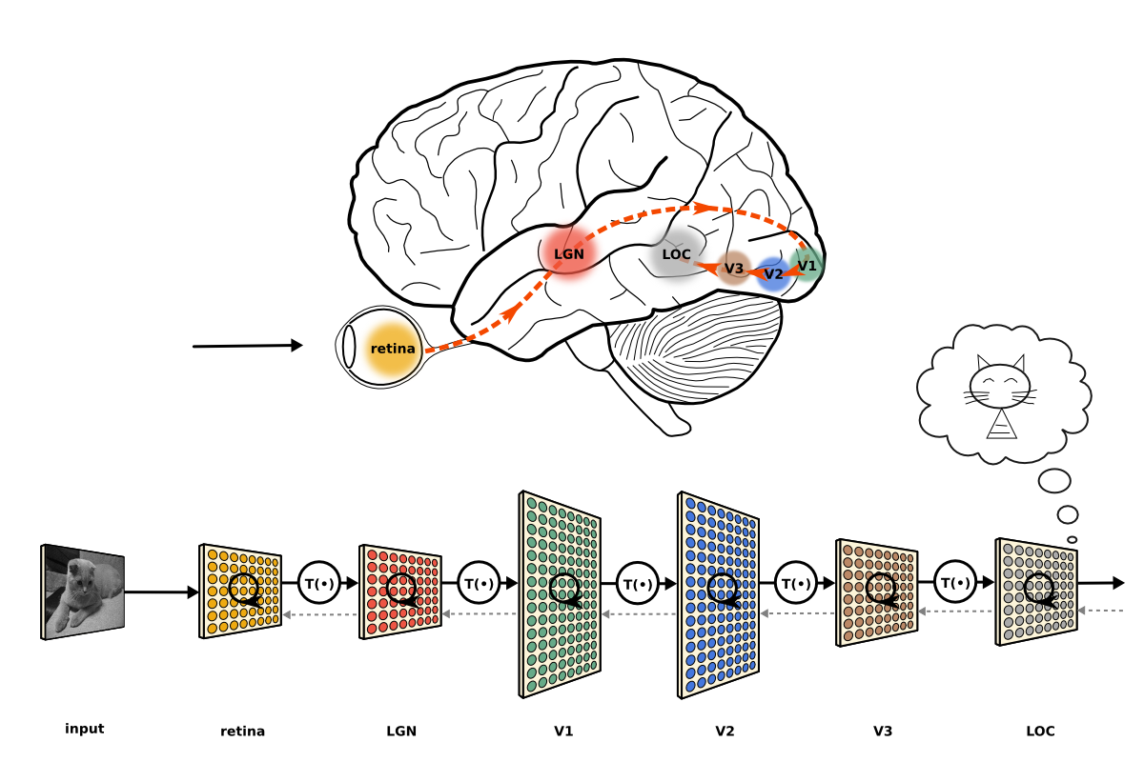
Convolutional Neural Networks (CNN)
Convolutional neural networks (CNNS) emerged from the study of the brain’s visual cortex, and they have been used in image recognition since the 1980s.
Thanks to the increase in computational power, the amount of available training data, and the tricks such as the smart initializations, ReLU etc, CNNs have managed to achieve superhuman performance on some complex visual tasks.
CNNs are successful not only at visual tasks, but also other tasks such as voice recognition or natural language processing (NLP)
Image: Jonas Kubilias

Slide 6
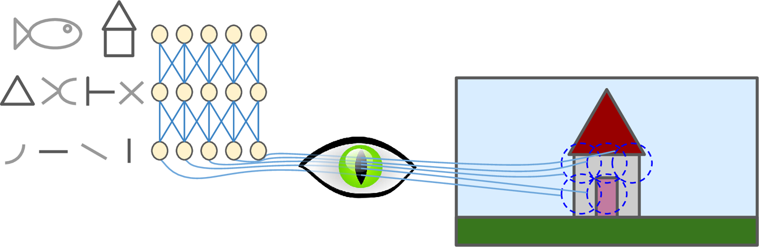
The Architecture of the Visual Cortex
Many neurons in the visual cortex have a small local receptive field
The receptive fields of different neurons may overlap, and together they tile the whole visual field
Some neurons react only to images of lines with specific orientations
Some neurons have larger receptive fields, and they react to more complex patterns that are combinations of the lower-level patterns
By Hubel & Wiesel of the 1981 Nobel Prize
small local receptive field

Slide 7
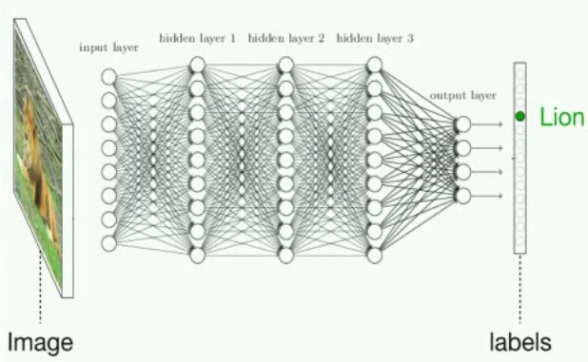
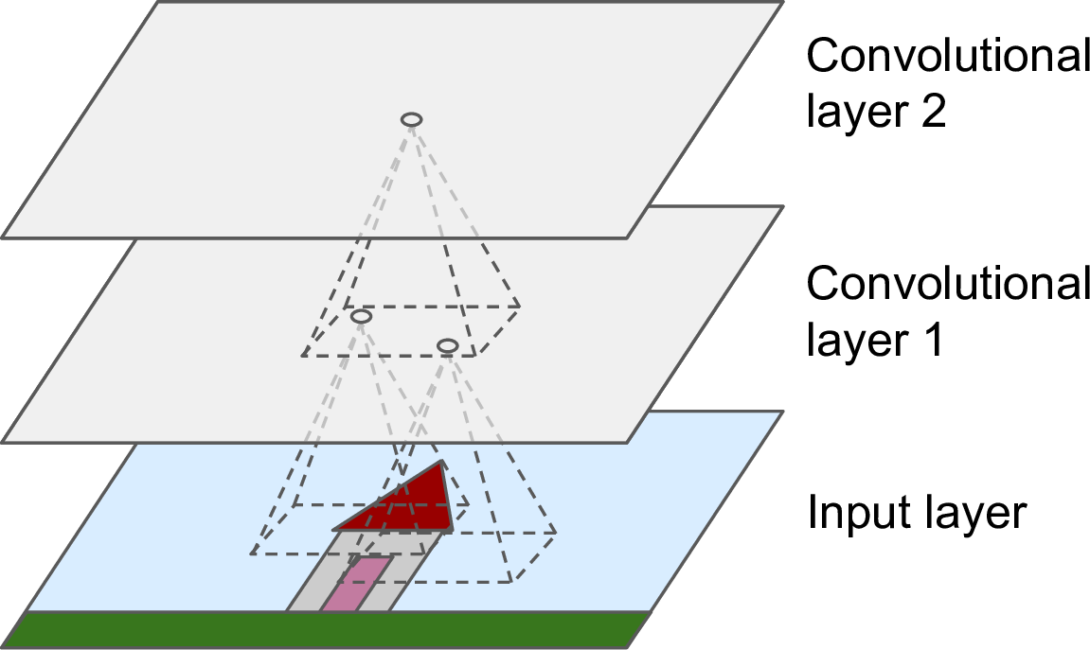
DNN vs. CNN
Deep Neural Network
Convolutional Neural Network
Receptive field
Neurons are connected to every single neuron (or pixel) in the previous layer (or input).
Input has to be flatten to 1D
Neurons are connected only to pixels in their receptive fields (or neurons within a small rectangle in the previous layer)
Input doesn’t need to be flatten

Slide 8
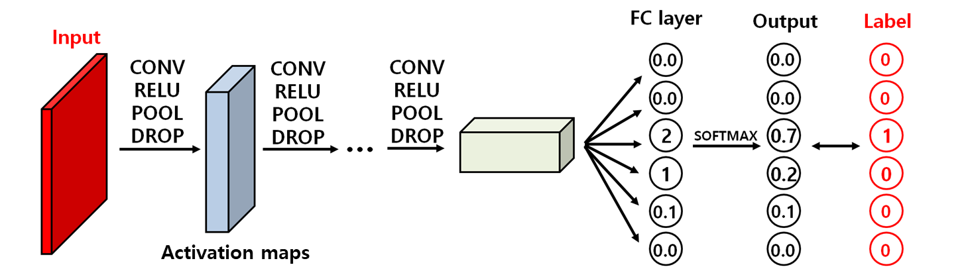
Architecture of CNN

Slide 9
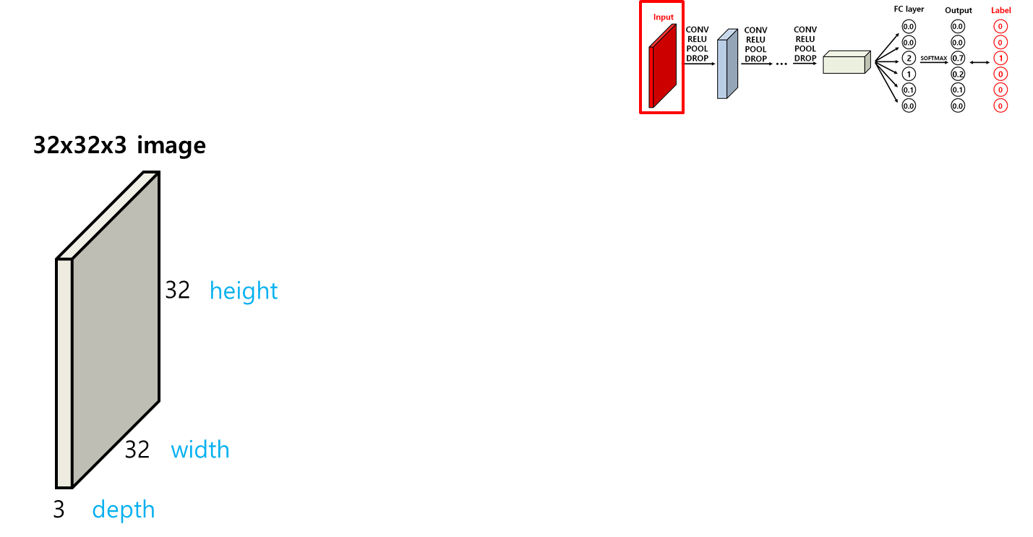
Input

Slide 10
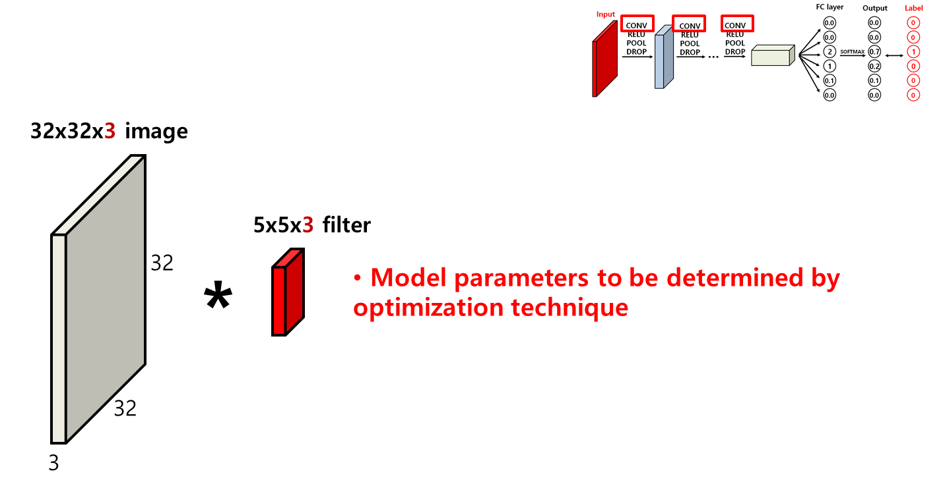
Convolution

Slide 11
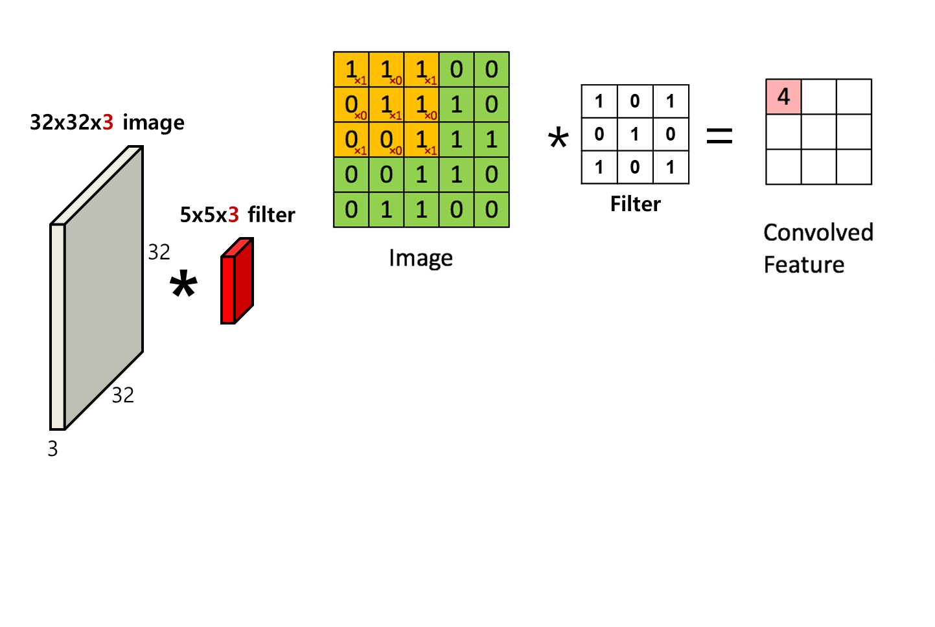

Convolution

Slide 12
Convolution
zero padding
0 | 0 | 0 | 0 | 0 | 0 | 0
0 | 1 | 1 | 1 | 0 | 0 | 0
0 | 0 | 1 | 1 | 1 | 0 | 0
0 | 0 | 0 | 1 | 1 | 1 | 0
0 | 0 | 0 | 1 | 1 | 0 | 0
0 | 0 | 1 | 1 | 0 | 0 | 0
0 | 0 | 0 | 0 | 0 | 0 | 0
2 | 2 | 3 | 1 | 1
1 | 4 | 3 | 4 | 1
1 | 2 | 4 | 3 | 3
1 | 2 | 3 | 4 | 1
0 | 2 | 2 | 1 | 1
1 | 0 | 1
0 | 1 | 0
1 | 0 | 1
=
*

Slide 13
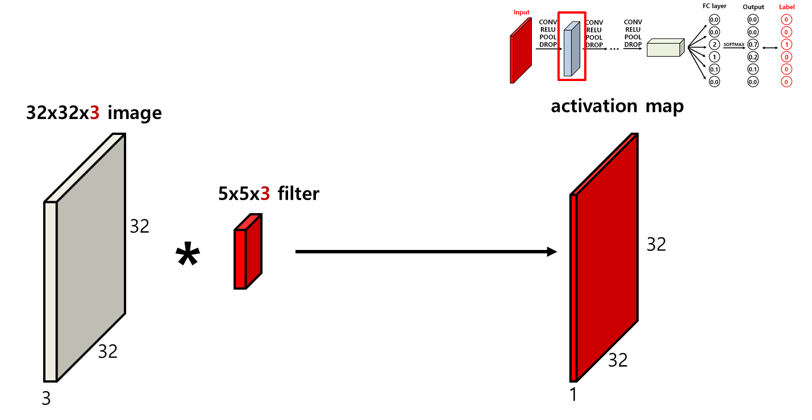
Activation maps

Slide 14
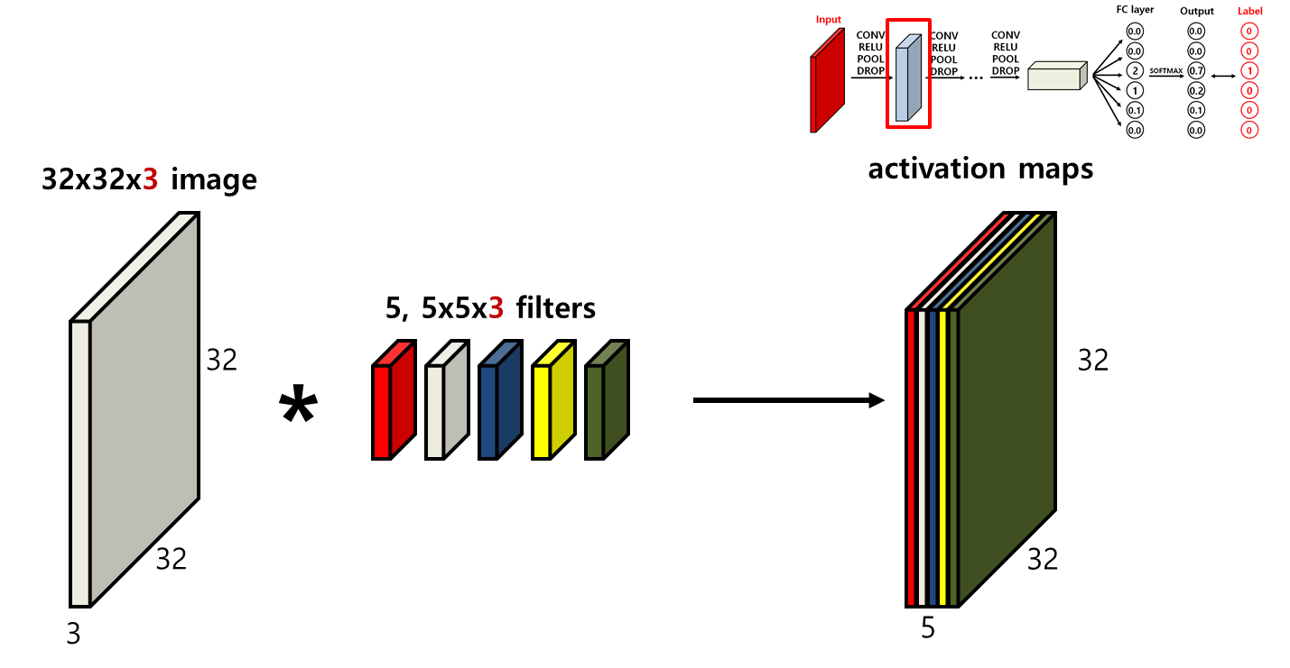
Activation maps

Slide 15
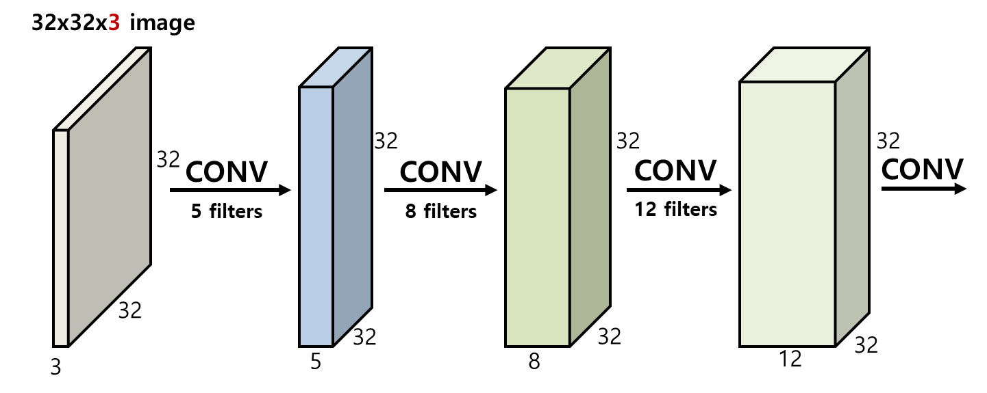
CONV with zero padding

Slide 16
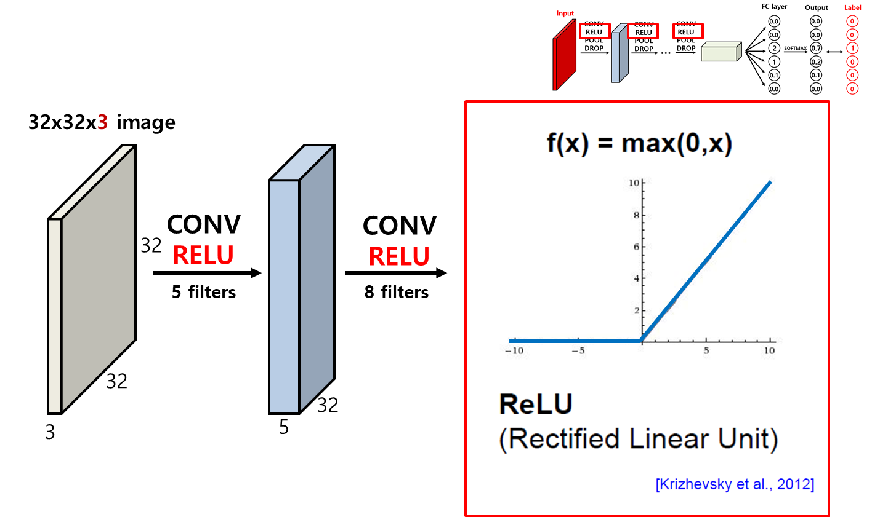
Rectified Linear Unit (ReLU)

Slide 17
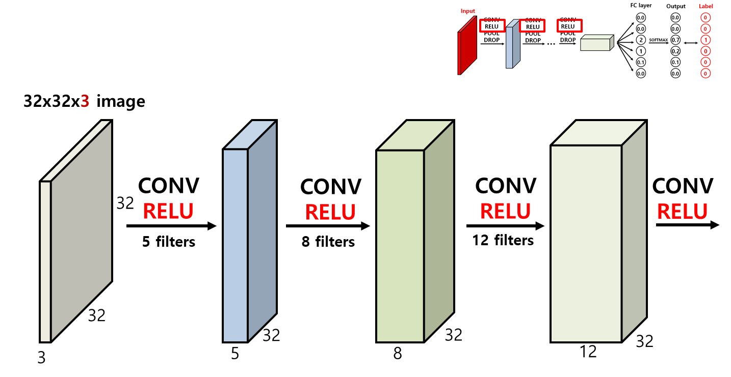
Rectified Linear Unit (ReLU)

Slide 18
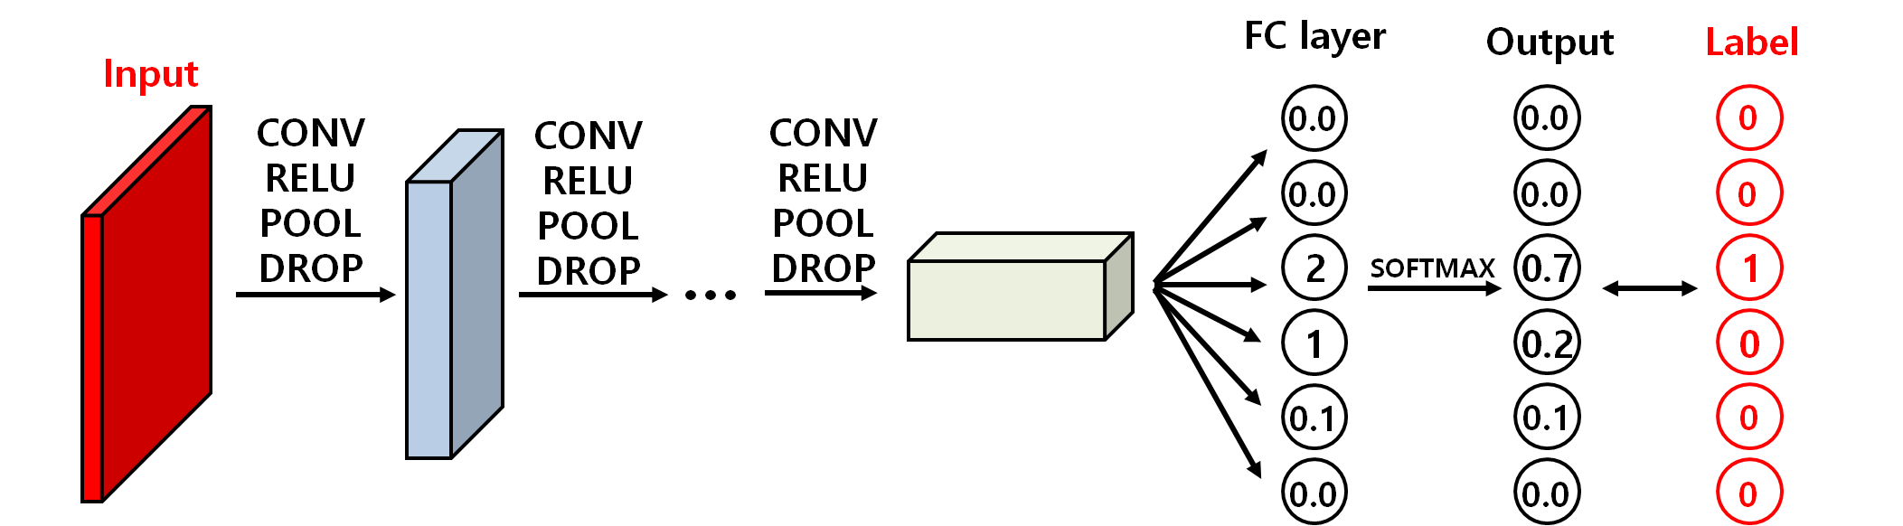
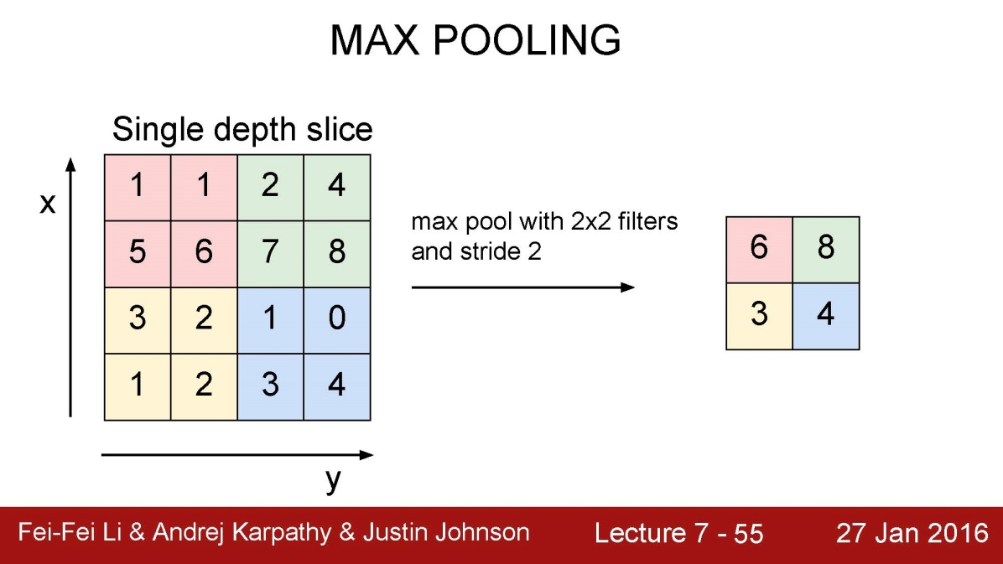
Max Pooling
CONV
RELU
32
POOL
16
12 filters
2X2 filter
2 strides
16
12
12
32

Slide 19
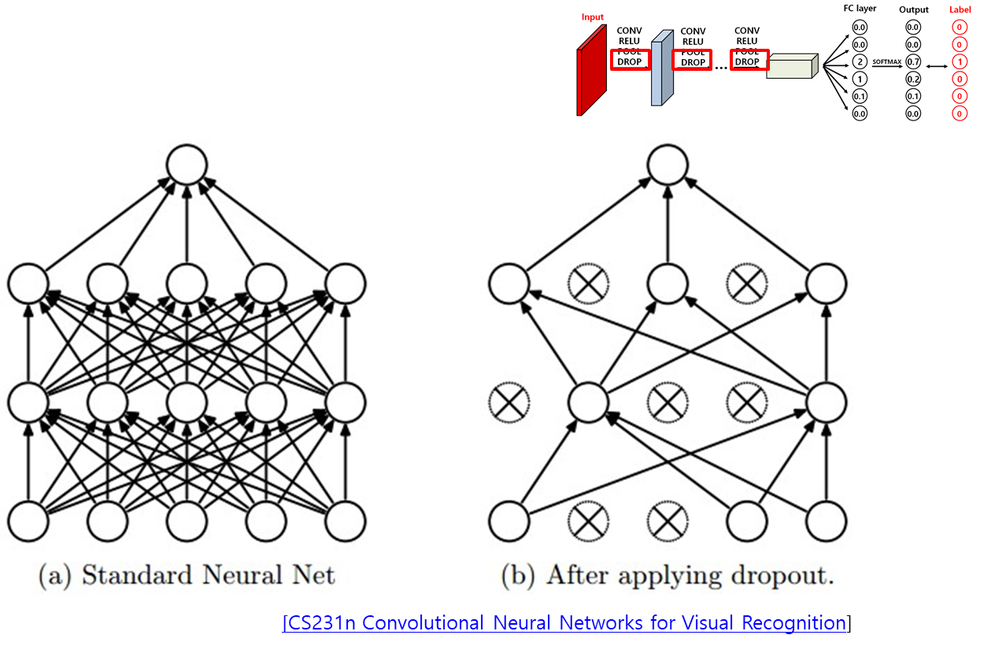
Dropout

Slide 20
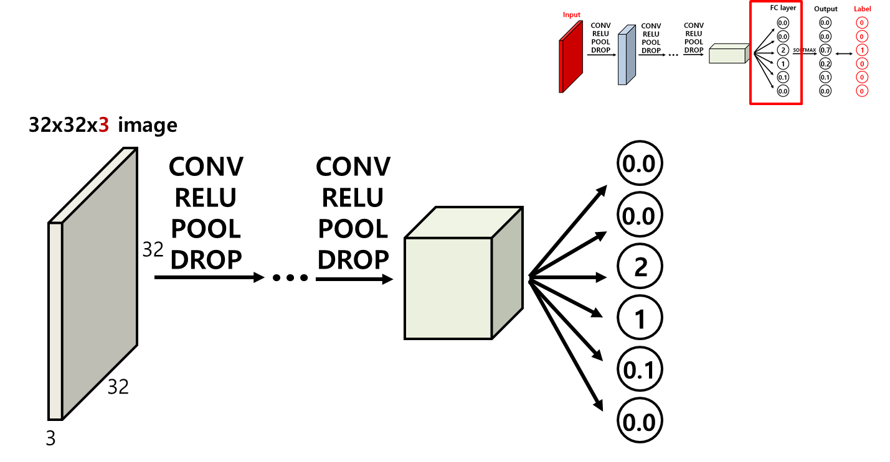
Fully connected layer

Slide 21
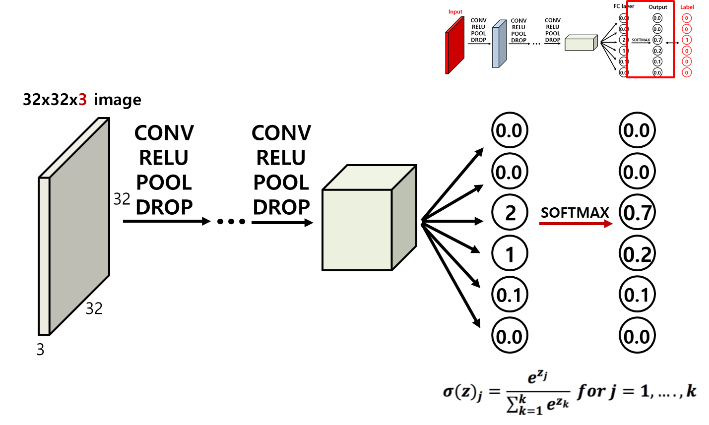
Softmax classifier

Slide 22
Label (One-hot encoding)
Converts a categorical features to numerical, eg.,
Features : cat, dog, horse, pig, cow, goat
cat
dog
horse
pig
cow
goat
→ [1, 0, 0, 0, 0, 0]
→ [0, 1, 0, 0, 0, 0]
→ [0, 0, 1, 0, 0, 0]
→ [0, 0, 0, 1, 0, 0]
→ [0, 0, 0, 0, 1, 0]
→ [0, 0, 0, 0, 0, 1]

Slide 23
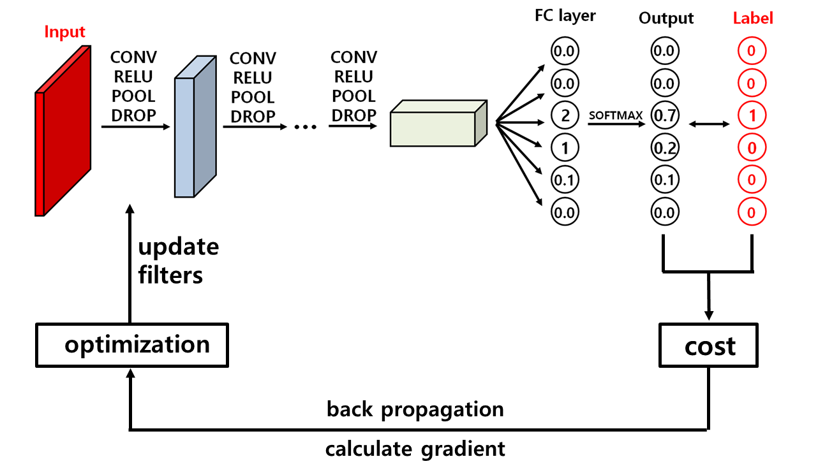
Optimization

Slide 24
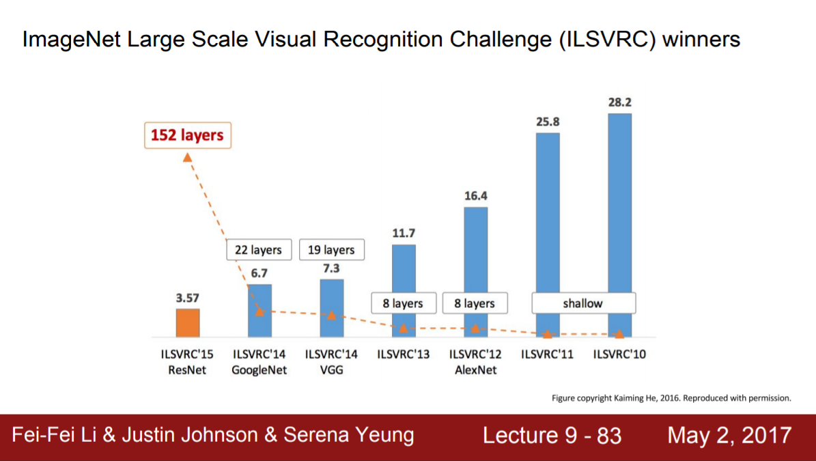

Slide 25

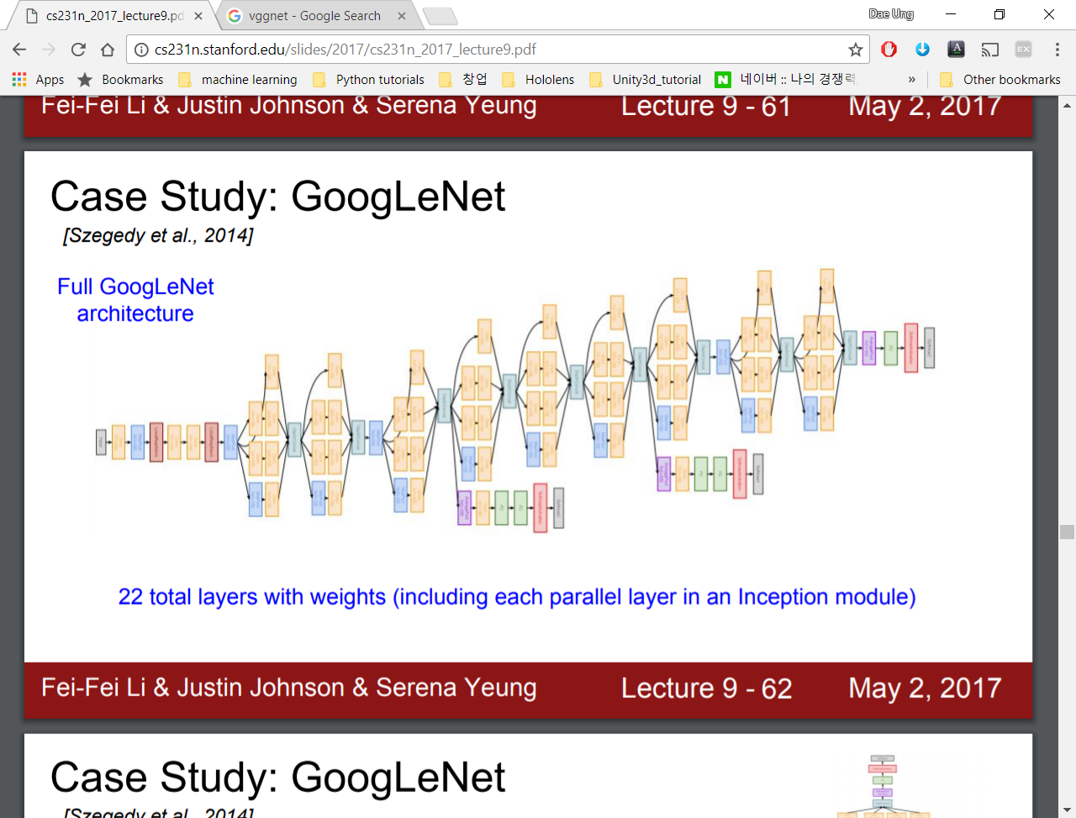
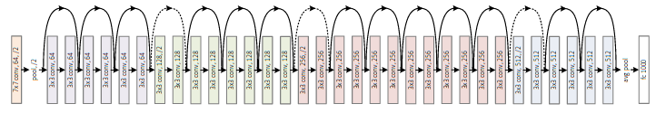
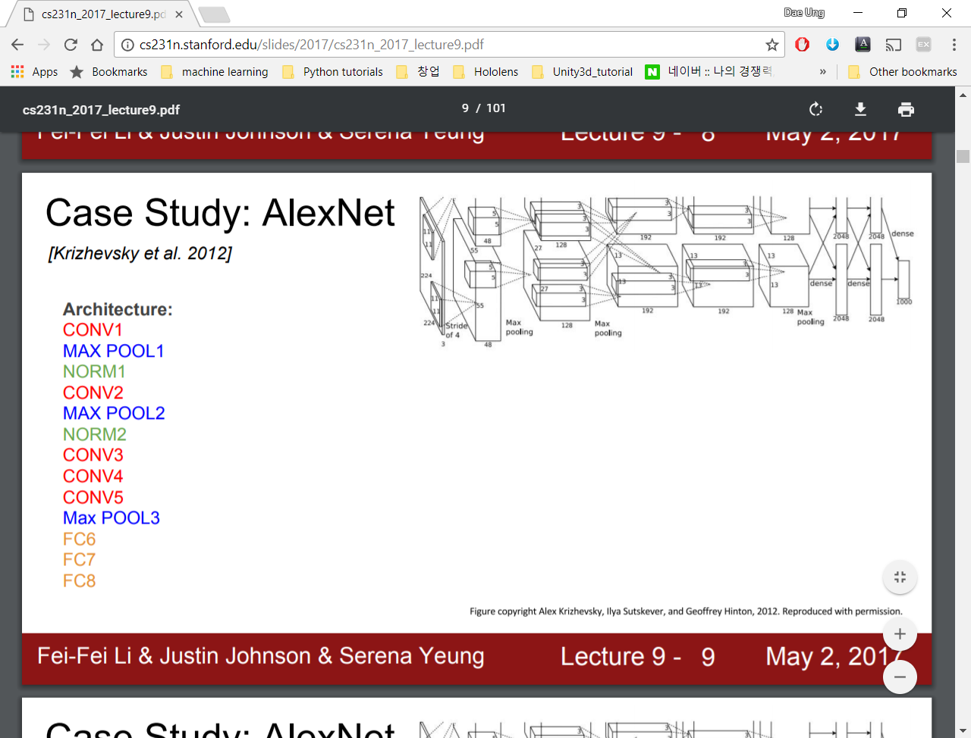
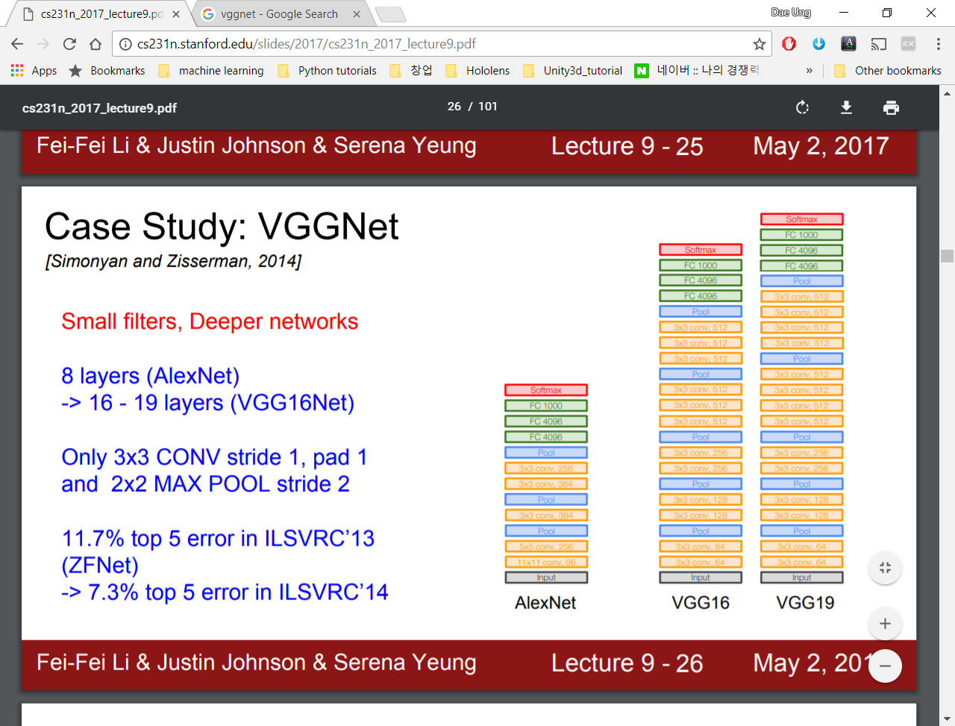
CNN Architectures
LeNet-5 (LeCun et al., 1998)
GoogLeNet (Szegedy et al., 2014)
AlexNet (Krizhevsky et al., 2012)
ResNet (He et al., 2015)
VGGNet (Simonyan and Zisserman, 2014)

Slide 26
Simple CNN for MNIST
CONV
RELU
CONV
RELU
…
…
28
POOL
RESHAPE
DENSE
?
…
…
32 filters
1 stride
64 filters
2 strides
2x2 filter
2 strides
28
?
10
1
?

Slide 27
Simple CNN for MNIST
CONV
RELU
CONV
RELU
?
…
…
28
POOL
RESHAPE
DENSE
28
…
…
32 filters
1 stride
64 filters
2 strides
2x2 filter
2 strides
?
?
28
28
10
1
32

Slide 28
Simple CNN for MNIST
CONV
RELU
CONV
RELU
14
…
…
28
?
POOL
RESHAPE
…
DENSE
…
28
32 filters
1 stride
64 filters
2 strides
2x2 filter
2 strides
14
?
?
64
28
28
10
1
32

Slide 29
Simple CNN for MNIST
CONV
RELU
CONV
RELU
14
…
…
28
7
POOL
RESHAPE
…
DENSE
…
28
32 filters
1 stride
64 filters
2 strides
2x2 filter
2 strides
14
7
64
64
28
28
10
1
32

Slide 30
Simple CNN for MNIST
CONV
RELU
CONV
RELU
14
…
…
28
7
POOL
RESHAPE
…
DENSE
…
28
32 filters
1 stride
64 filters
2 strides
2x2 filter
2 strides
14
7
64
64
28
28
10
1
32
64 x 7 x 7

Slide 31
12. Recurrent Neural Networks

Slide 32

Recurrent Neural Network (RNN)
Recurrent neural network (RNN) is a neural network model proposed in the 80’s for modeling time series.
The structure of the network is similar to feedforward neural network, with the distinction that it allows a recurrent hidden state whose activation at each time is dependent on that of the previous time (cycle).

Slide 33
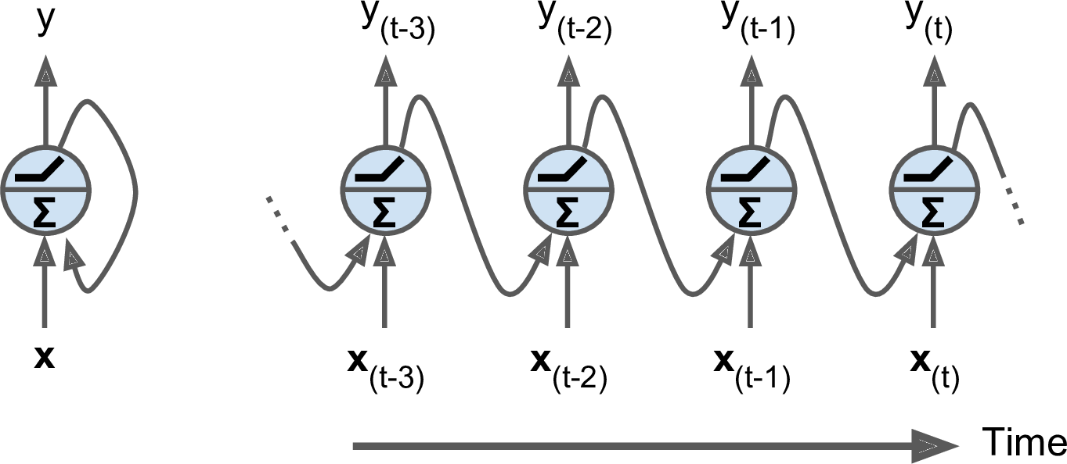
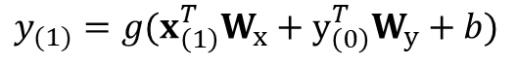
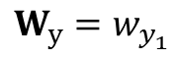
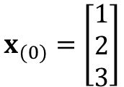
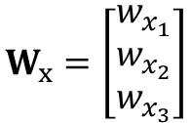
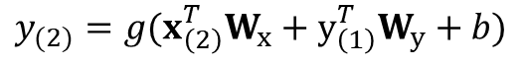
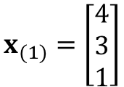
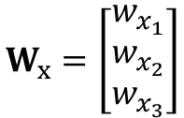
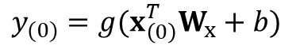
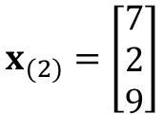
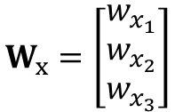
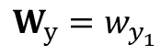
Simplest RNN
(0)
(1)
(2)
(3)
(0)
(1)
(2)
(3)
$$x_{(0)}=\left[\begin{matrix}1 \\ 2 \\ 3\end{matrix}\right]$$
$$W_{x}=\left[\begin{matrix}w_{x_{1}} \\ w_{x_{2}} \\ w_{x_{3}}\end{matrix}\right]$$
$$x_{(1)}=\left[\begin{matrix}4 \\ 3 \\ 1\end{matrix}\right]$$
$$W_{x}=\left[\begin{matrix}w_{x_{1}} \\ w_{x_{2}} \\ w_{x_{3}}\end{matrix}\right]$$
$$x_{(2)}=\left[\begin{matrix}7 \\ 2 \\ 9\end{matrix}\right]$$
$$W_{x}=\left[\begin{matrix}w_{x_{1}} \\ w_{x_{2}} \\ w_{x_{3}}\end{matrix}\right]$$
$$W_{y}=w_{y_{1}}$$
$$W_{y}=w_{y_{1}}$$
……
$$y_{(0)}=g(x_{\left(0\right)}^{T}W_{x}+b)$$
$$y_{(1)}=g(x_{\left(1\right)}^{T}W_{x}+y_{\left(0\right)}^{T}W_{y}+b)$$
$$y_{(2)}=g(x_{\left(2\right)}^{T}W_{x}+y_{\left(1\right)}^{T}W_{y}+b)$$
Activation function

Slide 34
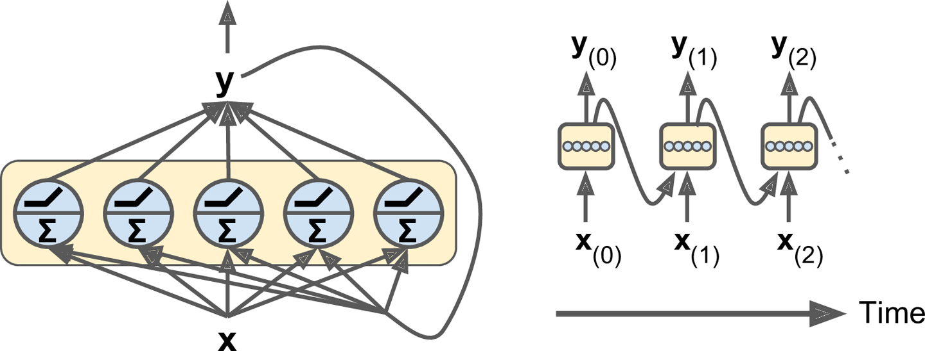
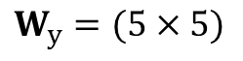
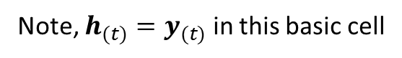
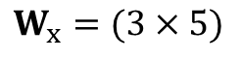
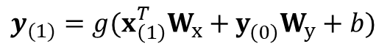
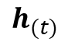
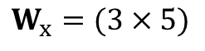
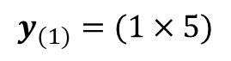
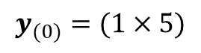
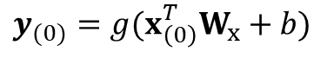
Simplest RNN
Cell’s state,
Note, $h_{(t)}=y_{(t)}$ in this basic cell
Output
$$h_{(t)}$$
Memory cell (or simply a cell)
$$x_{(0)}=\left[\begin{matrix}1 \\ 2 \\ 3\end{matrix}\right]$$
$$x_{(1)}=\left[\begin{matrix}4 \\ 3 \\ 1\end{matrix}\right]$$
$$W_{x}=(3×5)$$
$$W_{x}=(3×5)$$
$$W_{y}=(5×5)$$
……
$$y_{(0)}=g(x_{\left(0\right)}^{T}W_{x}+b)$$
$$y_{(1)}=g(x_{\left(1\right)}^{T}W_{x}+y_{\left(0\right)}^{}W_{y}+b)$$
$$y_{(0)}=(1×5)$$
$$y_{(1)}=(1×5)$$

Slide 35
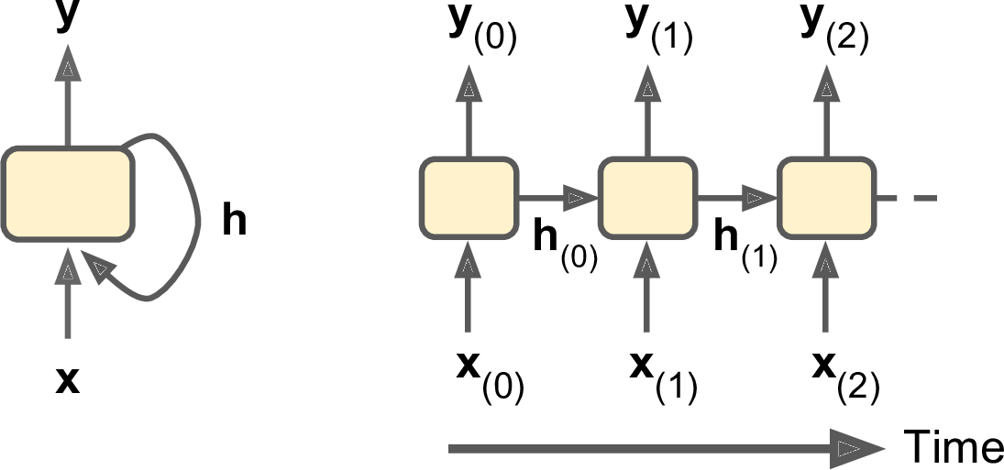
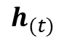
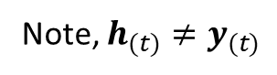
Simplest RNN
Output
Note, $h_{(t)}≠y_{(t)}$
Cell’s state,
$$h_{(t)}$$

Slide 36
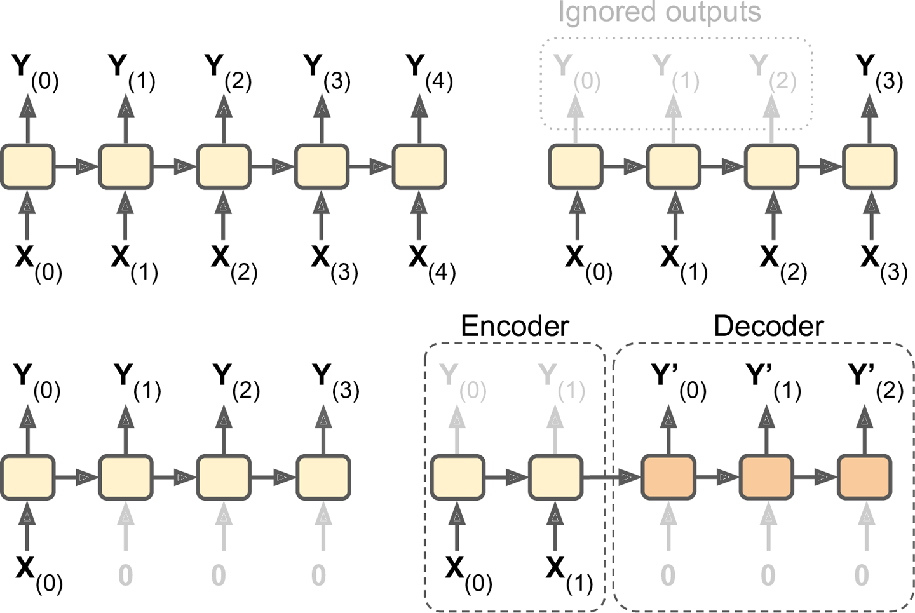
Process Sequences
Sequence to sequence
Sequence to vector
vector to sequence
Delayed sequence to sequence

Slide 37

Sequence to sequence example

Slide 38

Sequence to vector example
Action or Horror Movie?

Slide 39

Vector to sequence example
Man is playing guitar

Slide 40
Delayed sequence to sequence example
exploration of resources
자원 탐사

Slide 41



Training RNN
Cost = $C(Y_{{(t}_{min})},Y_{{(t}_{min})},…,Y_{{(t}_{max})})$

Slide 42

Deep RNN

Slide 43






Long Short-Term Memory (LSTM)
Introduced by Hochreiter & Schmidhuber (1997), and refined by many people
A special kind of RNN, capable of learning long-term dependencies
[Image: colah’s blog]

Slide 44

Long Short-Term Memory (LSTM)
Cell state
Kind of like a conveyor belt
Information flows along it with some minor linear interaction
: Cell state vector
[Image: colah’s blog]

Slide 45
Long Short-Term Memory (LSTM)
Forget Gate
Decide what information is going to be thrown away from the cell state
[Image: colah’s blog]

Slide 46
Long Short-Term Memory (LSTM)
Input Gate Layer
Decide which value will be updated
Create a vector of new candidate
[Image: colah’s blog]

Slide 47
Long Short-Term Memory (LSTM)
Update Cell State
[Image: colah’s blog]

Slide 48
Long Short-Term Memory (LSTM)
Output Gate Layer
Output to next layer
[Image: colah’s blog]

Slide 49


RNN for time series data with TensorFlow

Slide 50

RNN for MNIST with TensorFlow
2

Slide 51

Multi layers LSTM
2
LSTM
LSTM
……
LSTM
cell
LSTM
LSTM
……
LSTM
LSTM
LSTM
……
LSTM
layer
unit
lstm_cells = [tf.contrib.rnn.BasicLSTMCell(num_units=n_neurons)
for layer in range(n_layers)]
cell = tf.contrib.rnn.MultiRNNCell(lstm_cells)

